Slide 1

Project Title:- (MEDINOVA – Hospital Website)
Course: Web Application Development using Django
Institution: Sangam University Guided By: Ajay Kumar Suwalka Sir Submitted By: Lalit prajapat Enrollment Number : 2023SUBTCs026

Slide 2
Screenshots of website

Slide 3
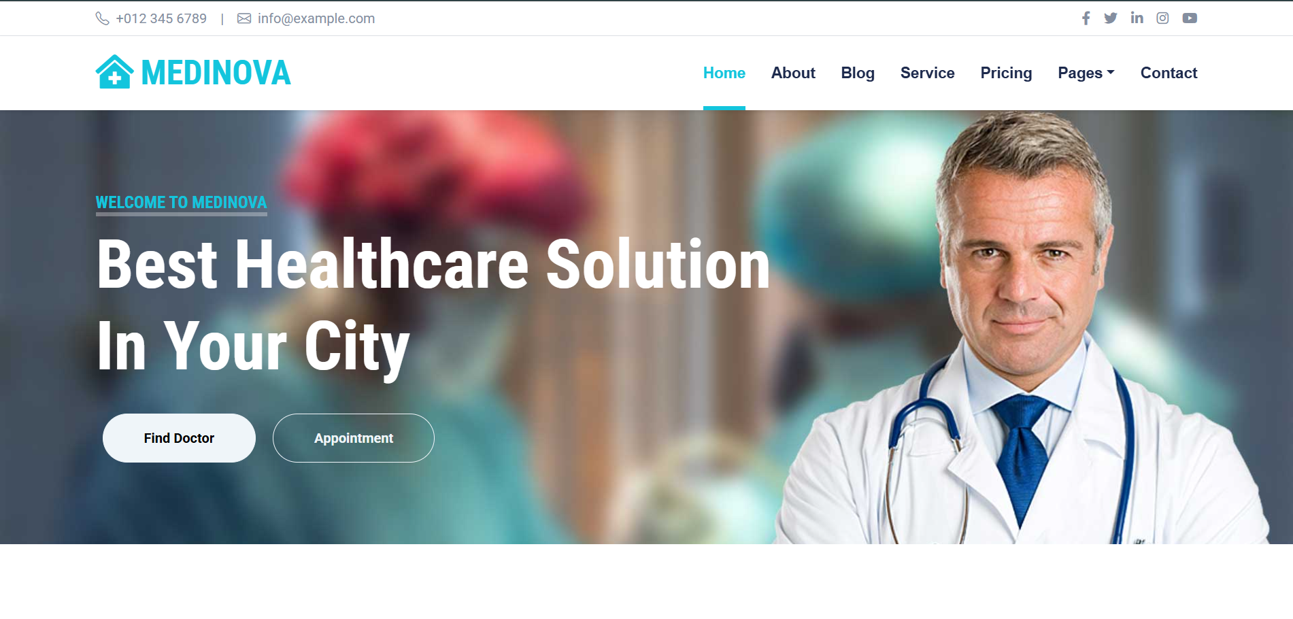
Home Page

Slide 4
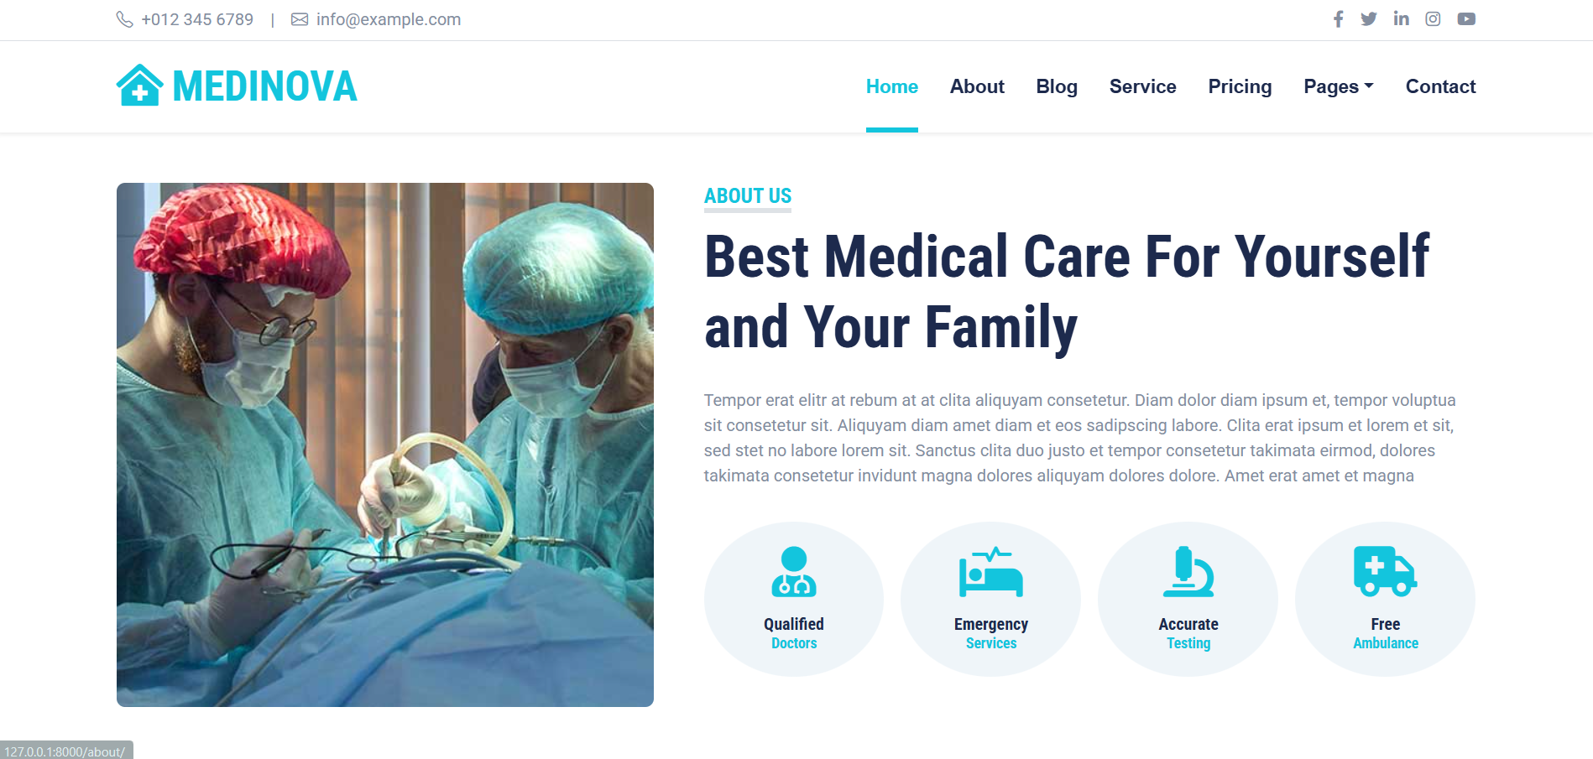
About Page

Slide 5
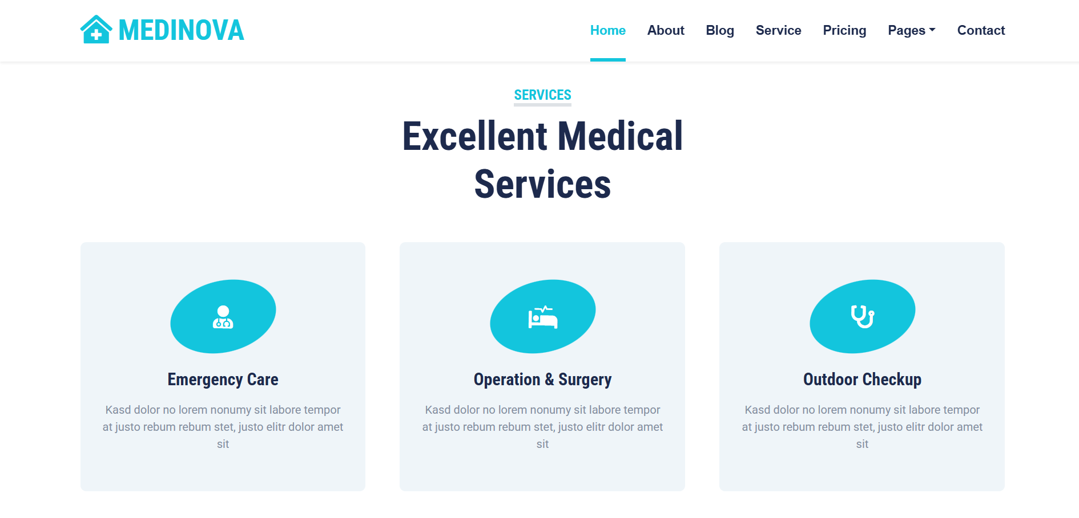
Services Page

Slide 6
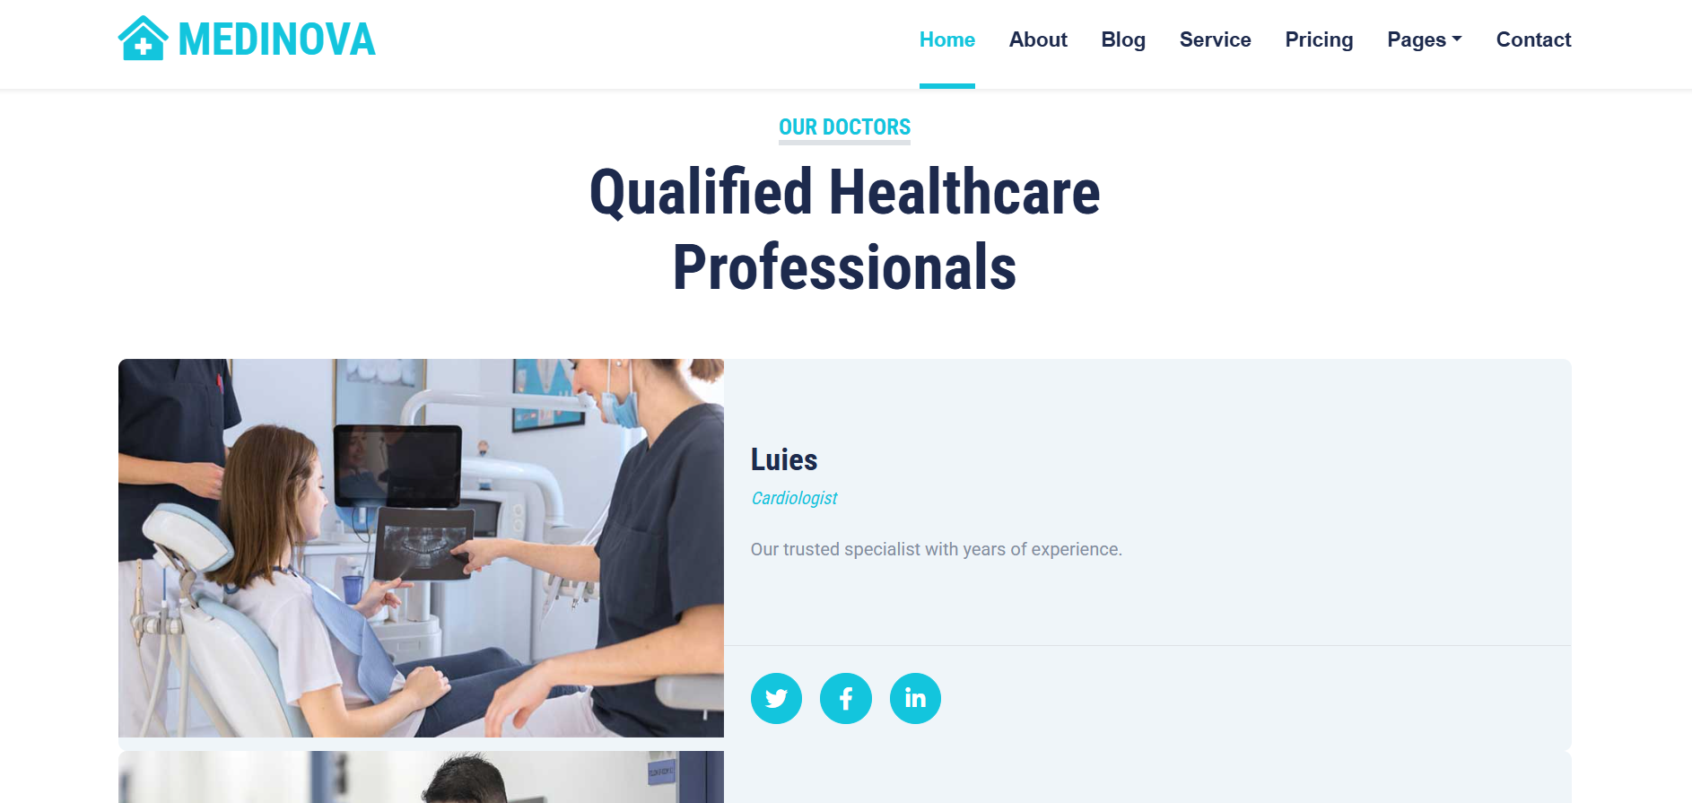
Doctors Page

Slide 7
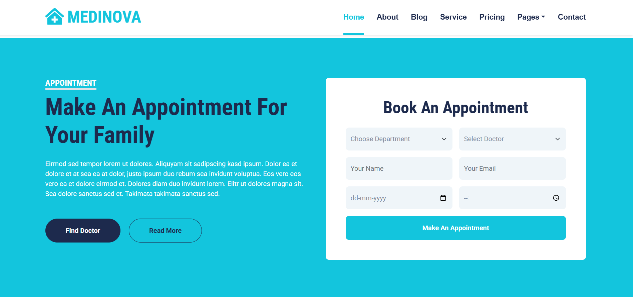
Appointment Page

Slide 8
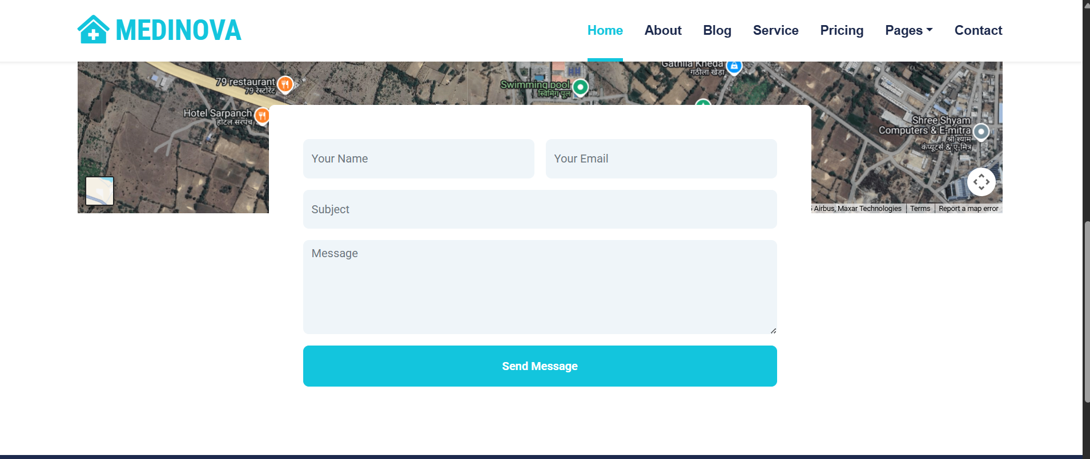
Contact Page
Contact Page

Slide 9
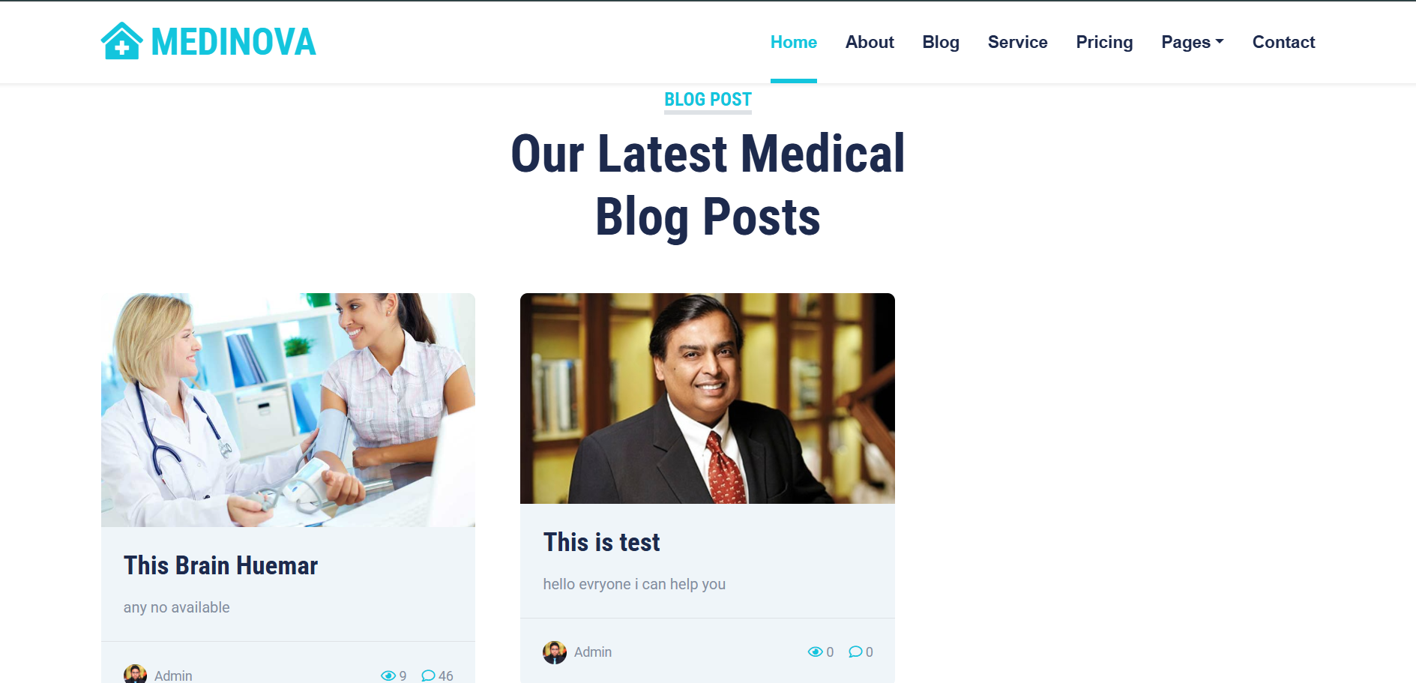
Blog Page

Slide 10
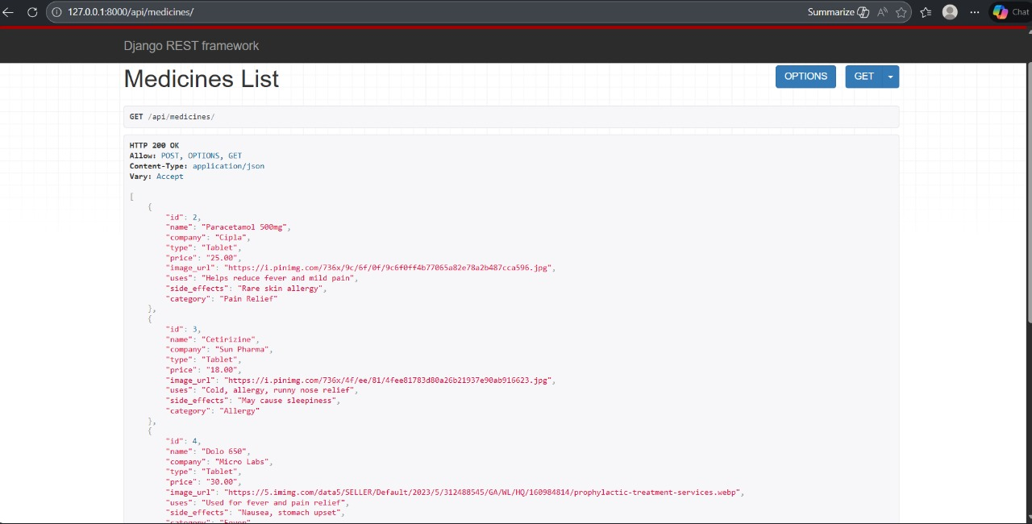
API Page

Slide 11
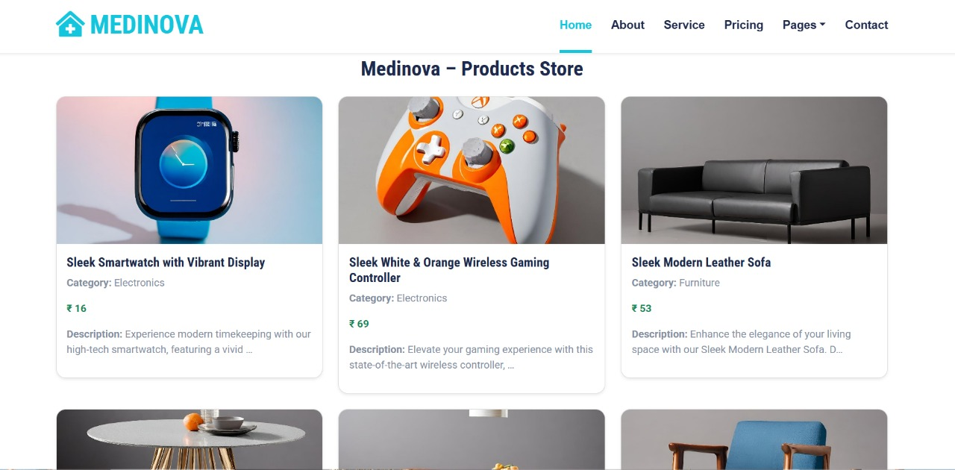
Third-Party API Integration Page

Slide 12
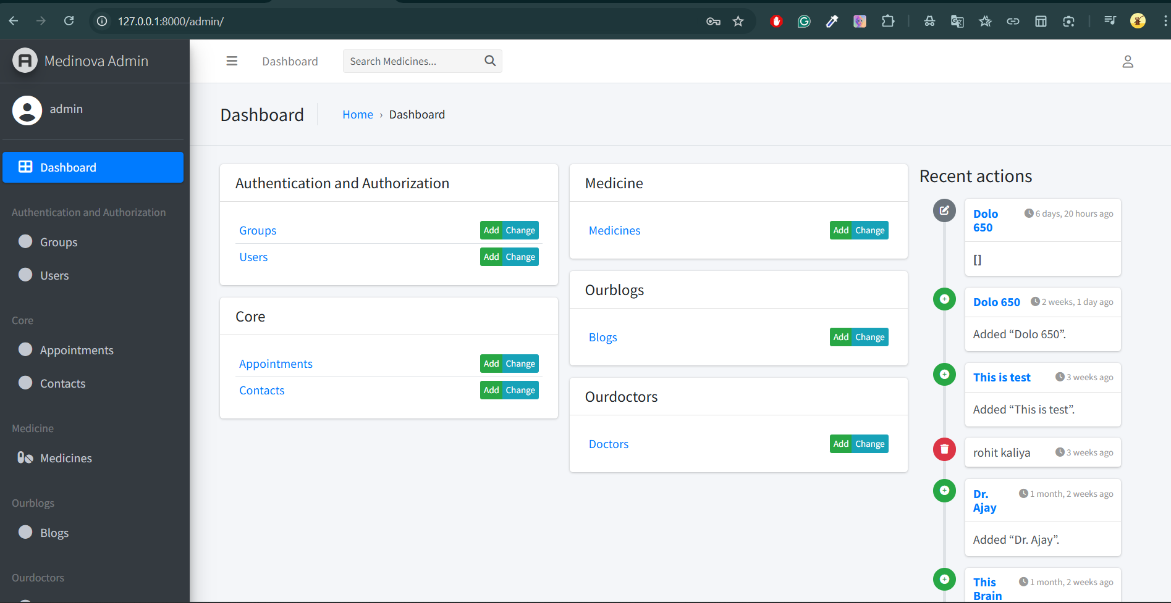
Admin Panel

Slide 13
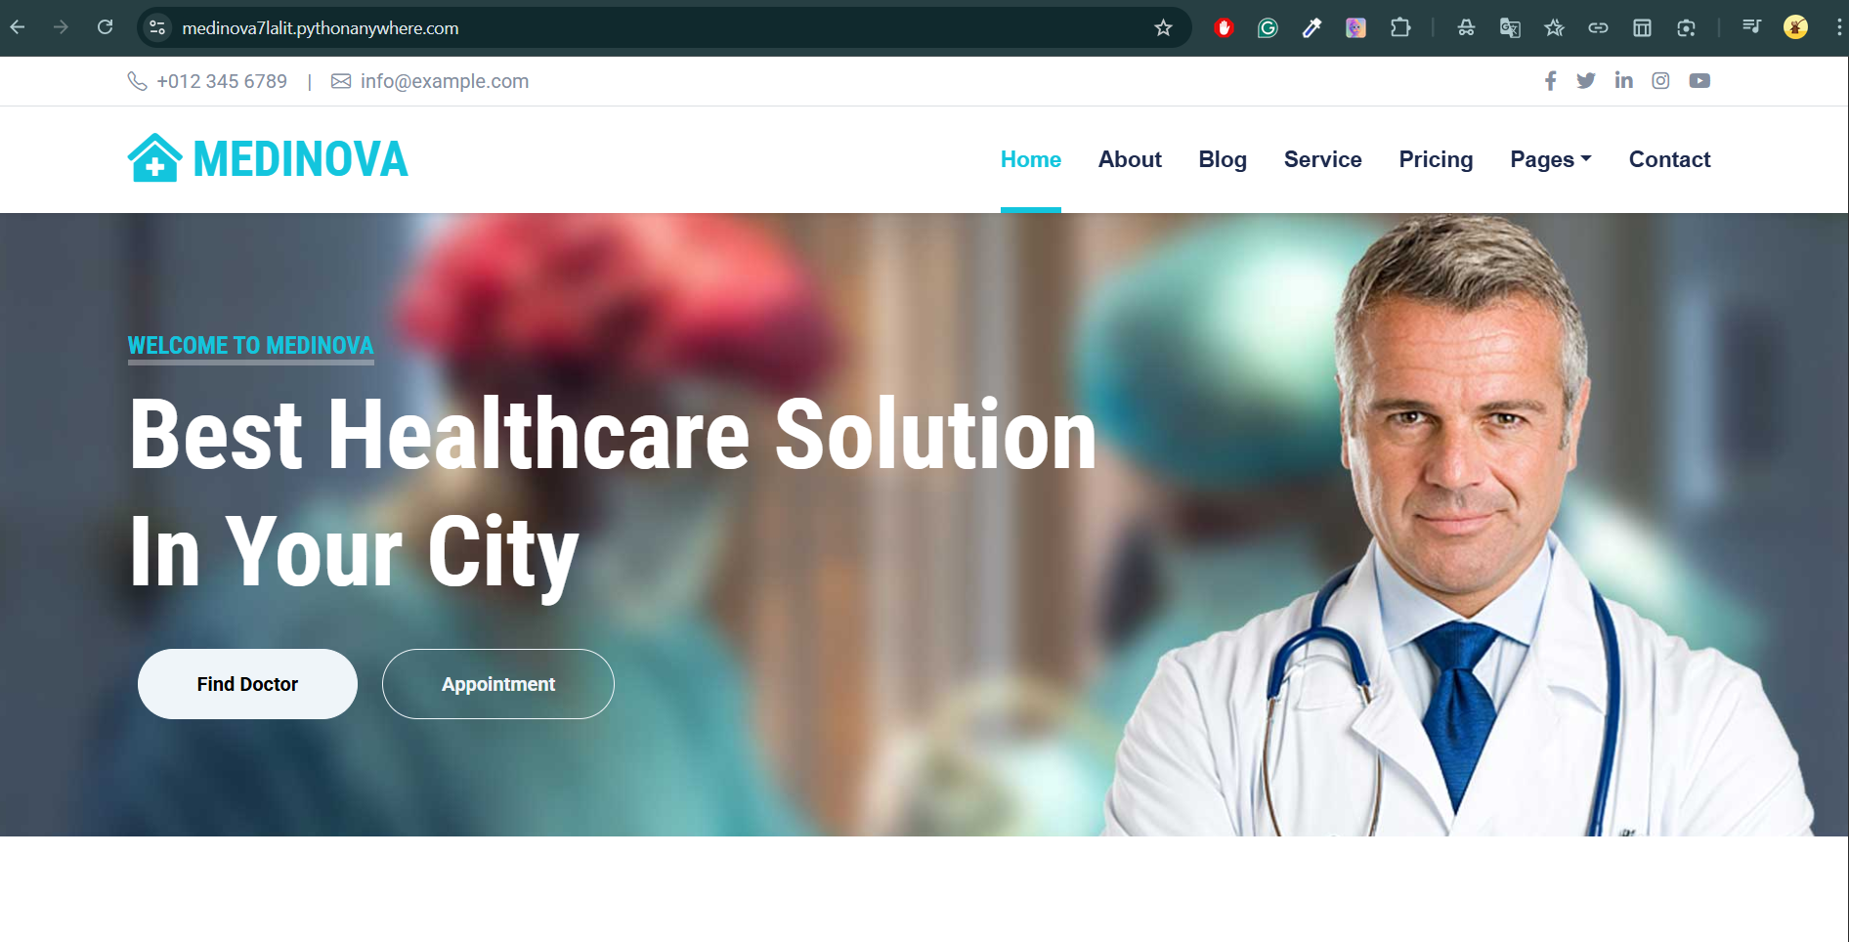
Hosted Website Screenshot (PythonAnywhere)

Slide 14
- Links -
Github Link :- https://github.com/lp7554499/medinova-hospital-website.git
Live hosting link (PythonAnywhere) :-https://medinova7lalit.pythonanywhere.com/

